Slide 1
Logging into http://books.quia.com
Screen Captures

Slide 2
Go to http://books.quia.com to arrive at this log-in page.

Slide 3
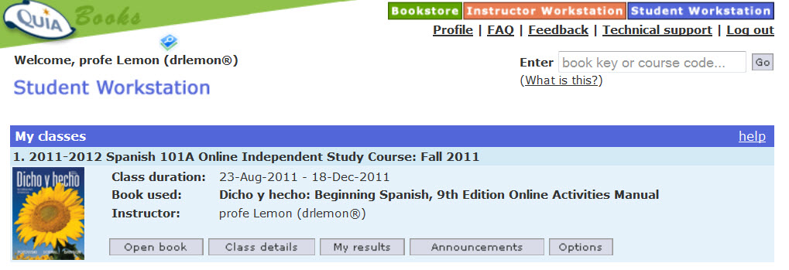
After you log in, you will arrive at your Student Station which will look like this:

Slide 4
If you have NOT entered your book key code, enter it now in the space in the upper right.

Slide 5
Now Click on MyResults. This is the fastest way to see what is assigned, what you have completed and what your grades are.

Slide 6
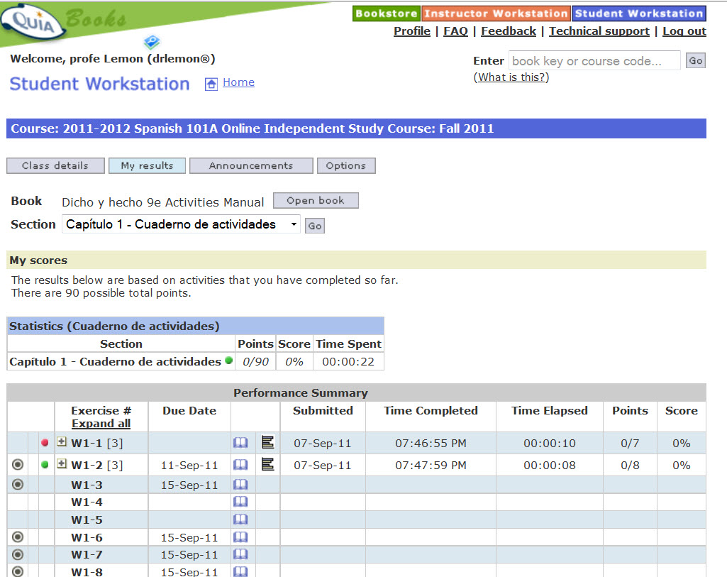
At the Section pull-down Menu, always select the option for “ALL” for each chapter.
Then click on “Go” to see everything assigned for that particular chapter.

Slide 7
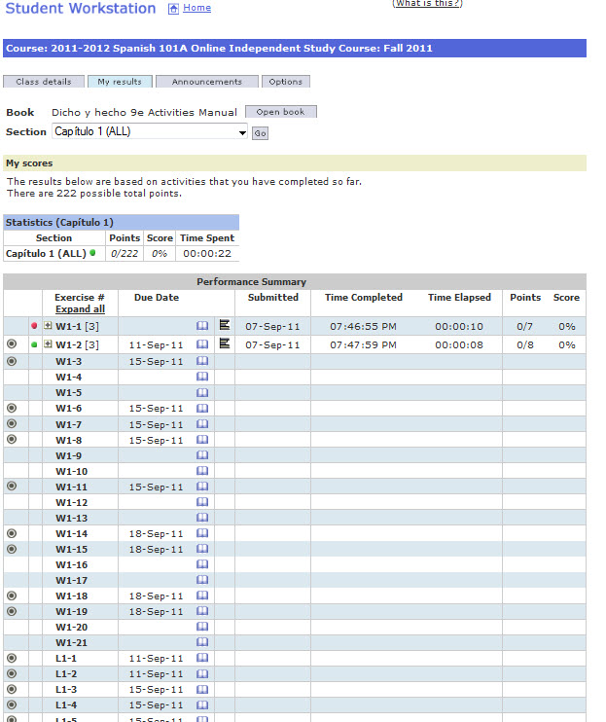
Once you select ALL and click on “go”, notice that both the workbook written homework and the Lab Manual listening exercises are visible all at once on the same page.

Slide 8
Red dots are assignments that your profe needs to grade.
Green dots are exercises that have been graded

Slide 9
Assignments with a bull’s eye or bullet next to it AND a due date, are assigned for a grade.

Slide 10
To access an assignment, click on the book icon next to the due date.

Slide 11
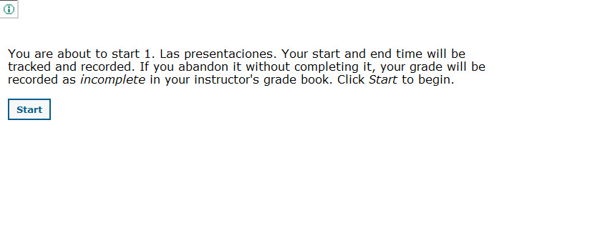
When you click on the book icon you will receive this start page warning you that you will be tracked and recorded. Abandoning is OK!! It will not count as an official attempt and will not hurt your grade.

Slide 12
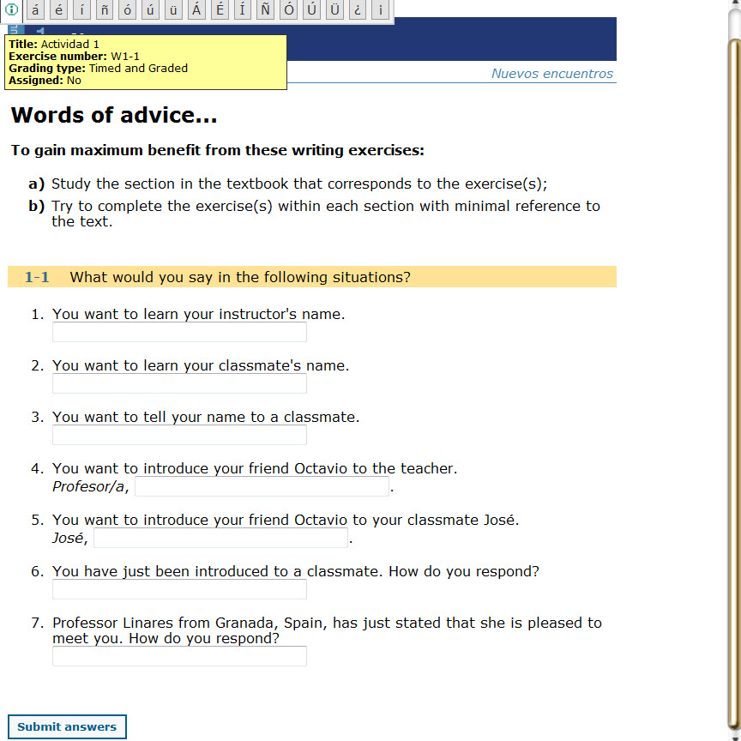
The exercise will open in a separate window.

Slide 13
Notice there is a floating keyboard at the top of the screen. Click on these letters to enter accented vowels and/or other Spanish characters.

Slide 14
Notice there is a bubble that lets you know what you are working on, how it is graded and if it is assigned for a grade.

Slide 15
This is VERY good advice. Study the text first, and do the online lecture readings, then do the practice activities in the Practice Zone on the online readings. This homework should then be your LAST activity with this material.

Slide 16
Once you have made a genuinely sincere attempt to complete this entire homework assignment, click on “Submit”

Slide 17
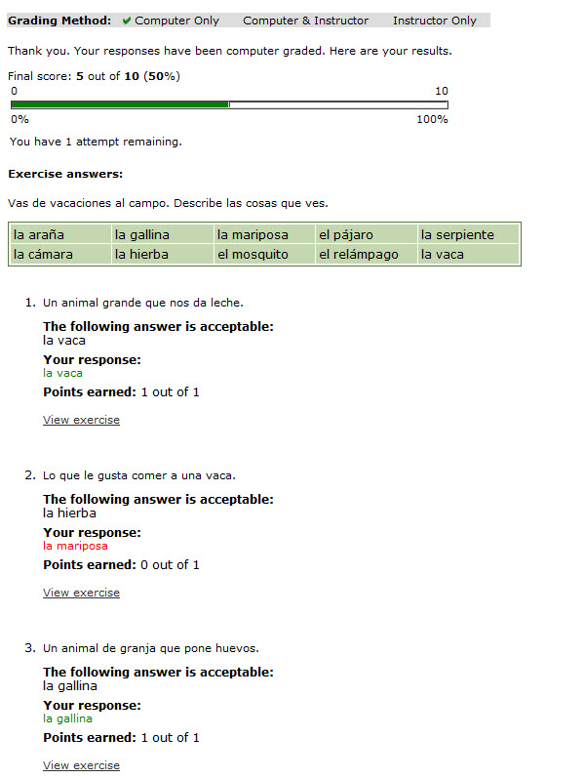
After you click on submit, You will see your scores and receive feedback.

Slide 18
DO NOT click on “Submit” if you have not finished the assignment. Do not click on “Submit” if you decide not to do this assignment.
Simply close the window.
Quia will credit you for the time spent, but will not consider this one of your 3 official attempts

Slide 19
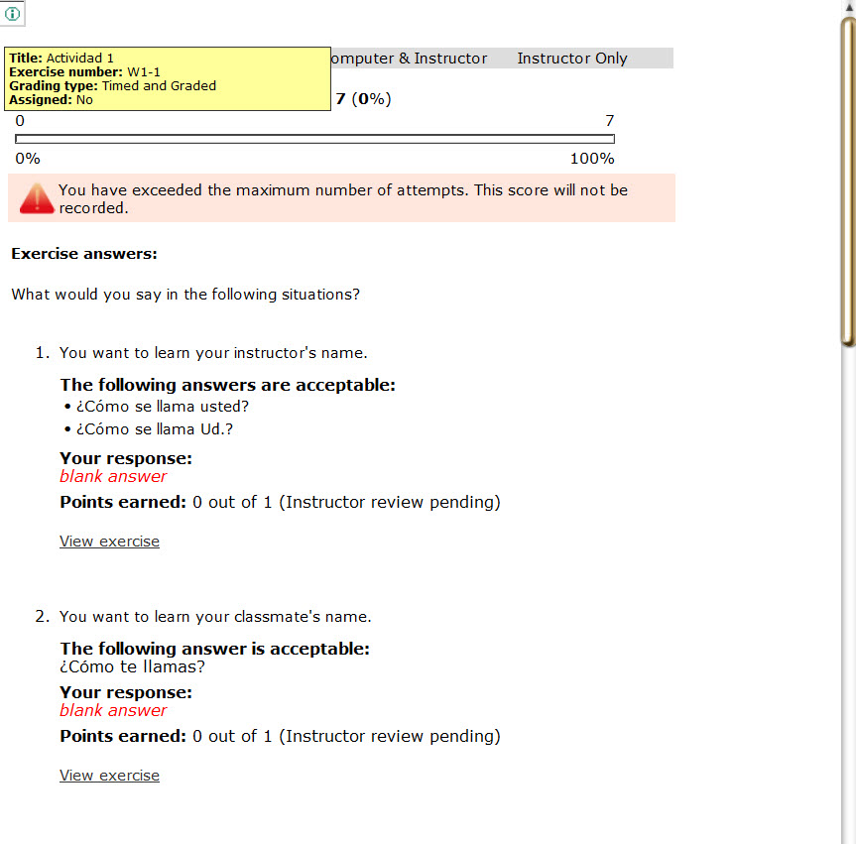
NEVER submit homework with blank answers, nor with nonsense answers in an attempt to get the answers to complete the homework.
Any instance of Blank Answers or any other form of academic dishonesty results in your being dropped or receiving an “F” for the course.
The system records your keystrokes as well as your time.

Slide 20
Once you have submitted your homework for the third (3rd) time, the system will notify you that subsequent practice attempts will not be submitted for a grade.

Slide 21
The computer will tell you what answers are acceptable, and it will show you what you submitted so you can see where you made any mistakes. Correct answers are in green.
Answers with errors will be in red.

Slide 22
At the top of the page, you will see three grading options:
Computer –graded,
Computer & instructor grades, & Instructor only graded.
One of these will be checked to let you know how this is being graded.

Slide 23
You will receive a score and a percentage grade for each assignment.

Slide 24
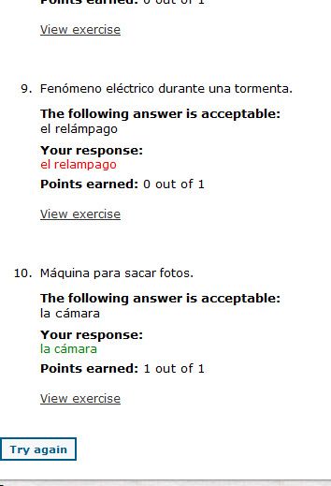
After you submit your answers and receive your score, you have the option to Try Again right away. You can chose to review the material and try again later, or if you see that your mistakes were small and simple, you can opt to fix them right away.

Slide 25
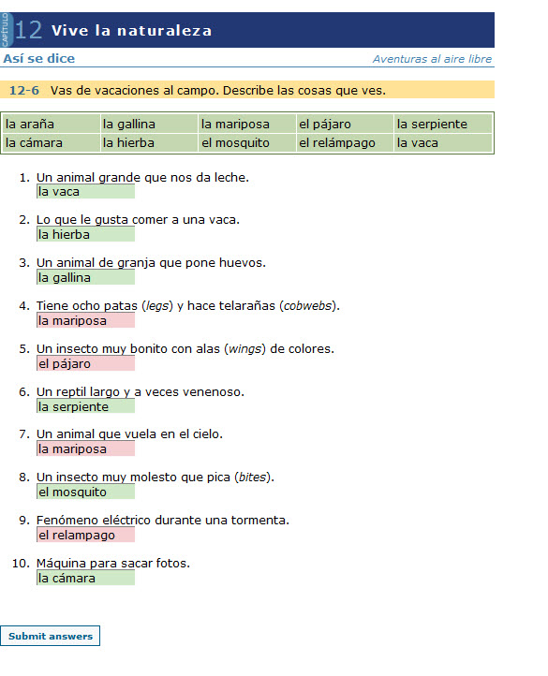
After you click on Try Again the system will take you back to the exercise where you can see your answers. Answers in green are correct. Answers in Pink (red) need to be fixed.

Slide 26
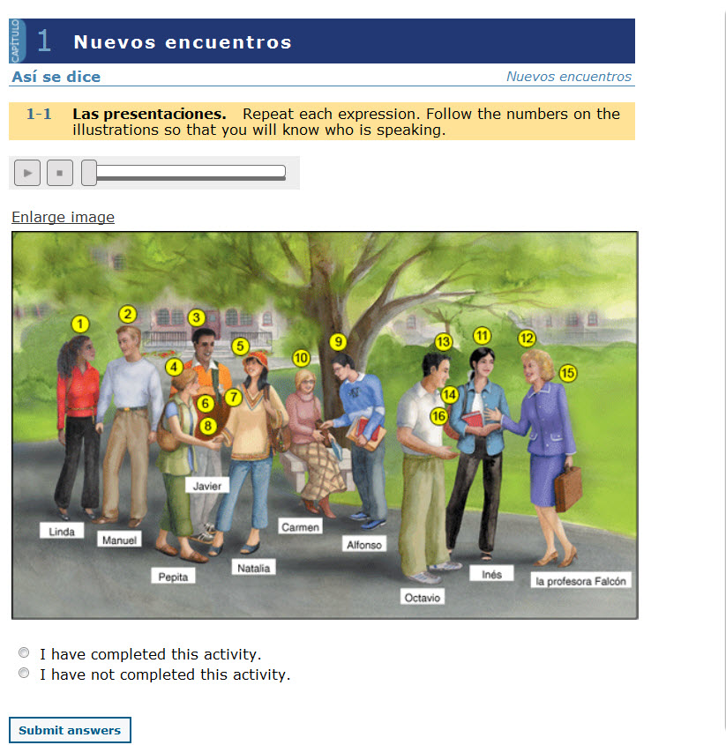
Lab Activities require speakers or headphones so you can hear the audio.
Click here for the audio.

Slide 27
Repeat what you hear to work on your pronunciation. Listen repeated times. Even after the grading has passed you have access for practice.
When you are finished, be sure to select “I have Completed this Activity.”
Again, selecting
this option and submitting answers when you did not actually do the activity results in being dropped or receiving an F in the course.

Slide 28
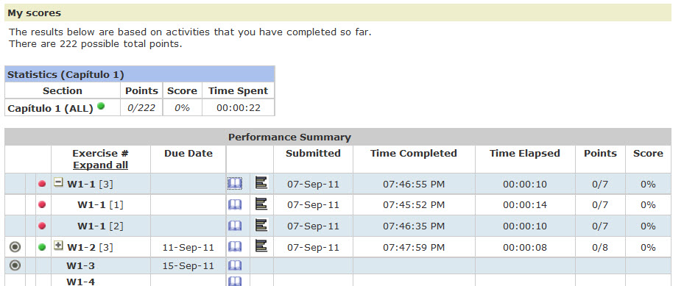
When you are through with your homework attempts, close the assignment window to return to your MyResults screen. Refresh this screen to see updated scores (remember the assignments are in another window and it won’t synch automatically unless you sign-out or refresh.)

Slide 29
Here you can see all the attempts I made on assignment 9. Notice the system has my 3rd attempt listed first. This was my best attempt so it is my final grade. Notice I looked at assignments 7 and 8 but I CLOSED THE WINDOW without clicking on Submit.
The dashes show I looked at it, played around with it, but I did not submit it for a grade. This does NOT count against me At All.
It is perfectly fine to look at assignments and choose not to work on them or finish them if you feel you need more review first.

